Slide 1
Public Safety Building

Slide 2
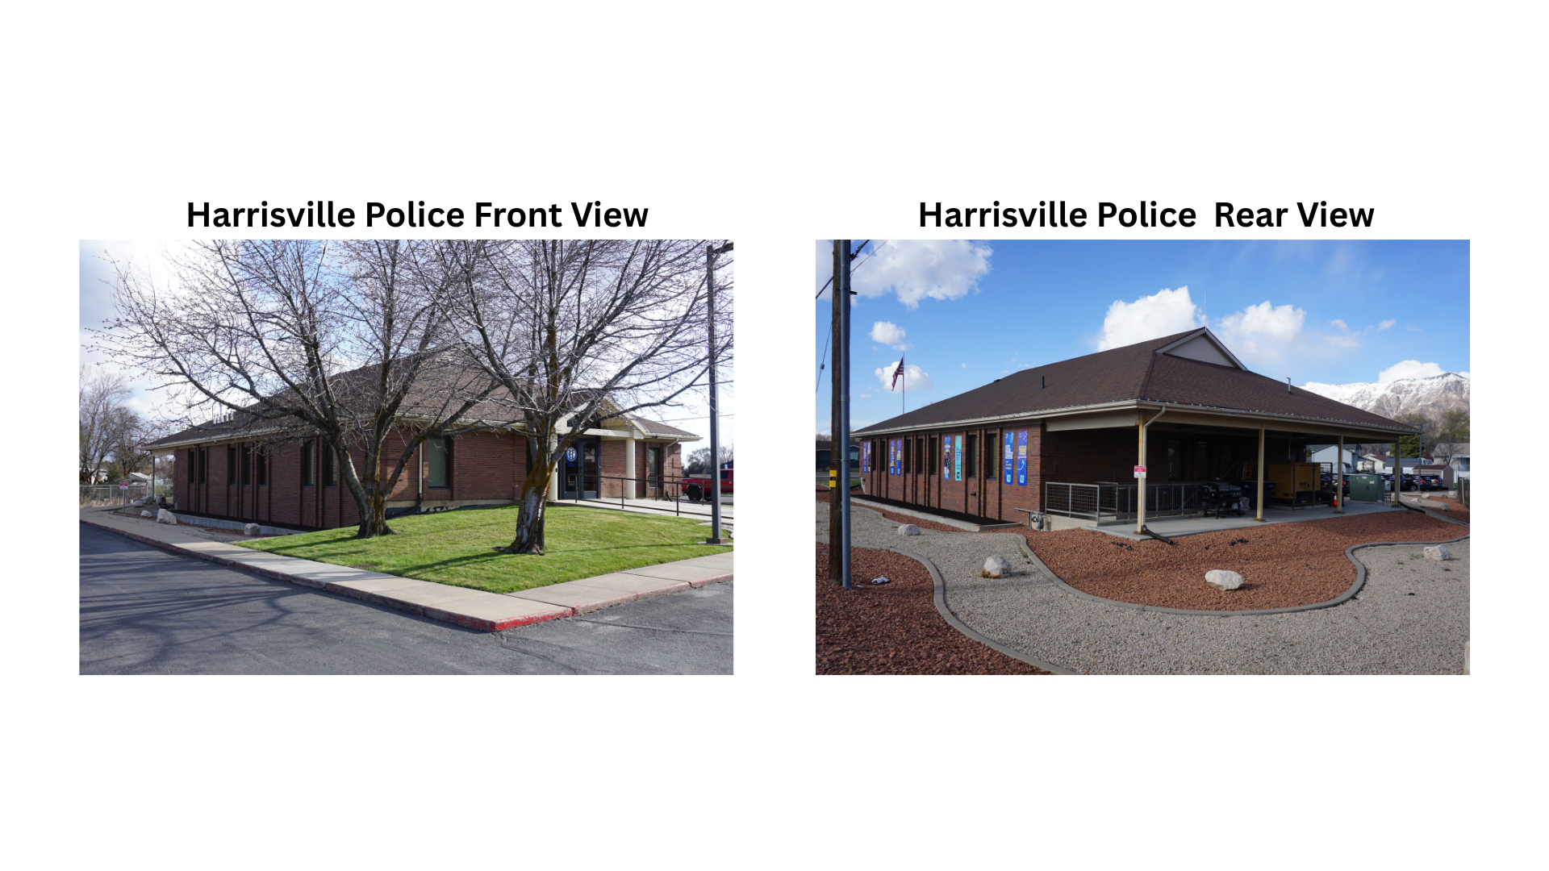
Harrisville Police Department

Slide 4
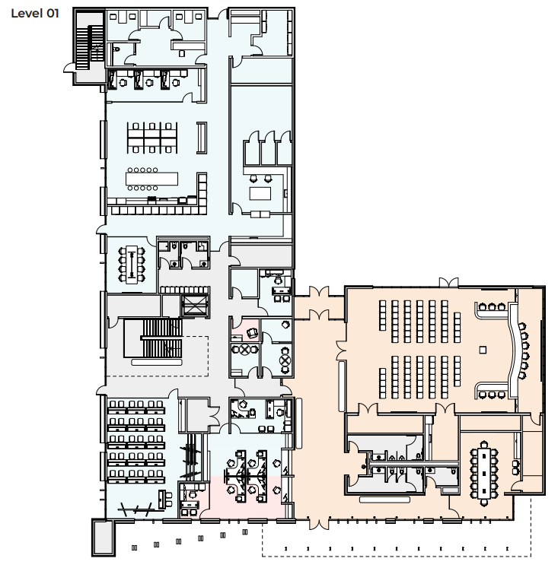
Main Level of Public Safety Building

Slide 5
Building Access

Slide 8
Patrol Room

Slide 10
Evidence Room

Slide 13
DUI Processing

Slide 15
Interview Rooms

Slide 17
Public Safety Building Budget
Project Costs
Construction $12.5 M
Professional A/E Fees $1.3M
2023 - $9M Sales and Franchise Tax Revenue Bonds
2025 - $3.5M Sales and Franchise Tax Revenue Bonds
$560,000 Interest on $9M Bonds paying for $566,000 of A/E Fees through July 2025
Balance of $740,000 (Paid with sale of current City Hall and/or other city properties.)

